Slide 1
Announcements
There is a midterm at 8 PM today in this room, so it might get a little noisy towards the end of lecture.
For HW: Make sure to submit to both gradescope and datahub by the deadline.
Sorry for the awkward submission system. Our infrastructure is new.
If applicable, please fill out the midterm and final exam conflict forms by Friday.

Slide 2

Linear Models & Feature Engineering
?
Slides by:
Joseph E. Gonzalez jegonzal@cs.berkeley.edu

Slide 3
Regression and Linear Models

Slide 4
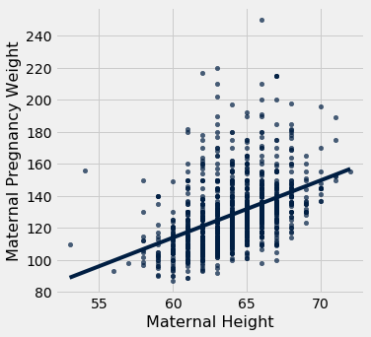

The Regression Line (Data 8)
In Data 8, you talked about generating the regression line.
Given scalar data y and x, find m and b that minimizes the mean squared error (a.k.a. L2 Loss).
$${Loss=\left(y−\left(mx+b\right)\right)}^{2}$$

Slide 5
Regression
Estimating relationship between X and Y.
Y is a quantitative value.
X can be almost anything …
X
Domain
Y
Model

Slide 6
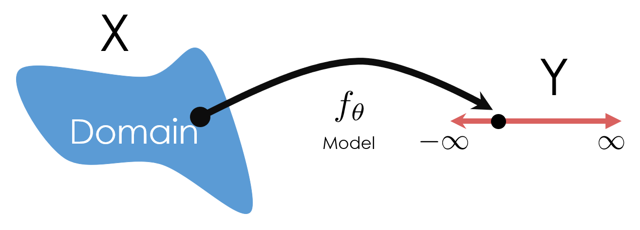
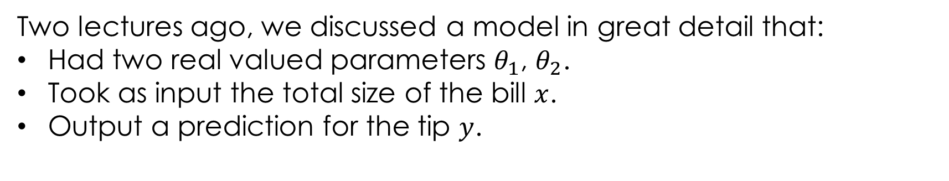
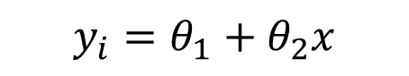
Regression Example #1
Two lectures ago, we discussed a model in great detail that:
Had two real valued parameters $θ_{1}$, $θ_{2}$.
Took as input the total size of the bill $x$.
Output a prediction for the tip $y$.
Then showed solution could be derived using calculus + algebra:
$$y_{i}=θ_{1}+θ_{2}x$$
Notes:
Maybe add specific example

Slide 7
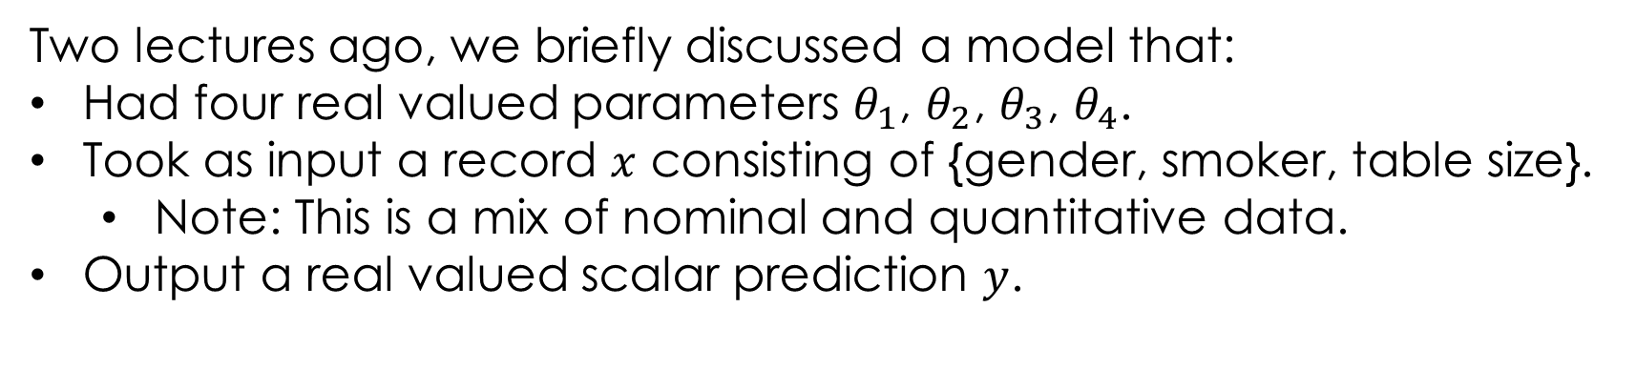
Regression Example #2
Two lectures ago, we briefly discussed a model that:
Had four real valued parameters $θ_{1}$, $θ_{2}$, $θ_{3}$, $θ_{4}$.
Took as input a record $x$ consisting of {gender, smoker, table size}.
Note: This is a mix of nominal and quantitative data.
Output a real valued scalar prediction $y$.
Might seem hopeless to try to solve, but today we’ll see it’s possible!
$$y_{i}=θ_{1}^{∗}+θ_{2}^{∗}𝕀\left(x_{i} is ′Male^{′}\right)+θ_{3}^{∗}𝕀\left(x_{i} is^{ ′}Smoker^{′}\right)+θ_{4}^{∗}size(x_{i})$$
Notes:
Maybe add specific example

Slide 8
Least Squares Linear Regression
One of the most widely used tools in machine learning and data science
Linear Model
Linear in the Parameters
Feature Functions
Squared Loss
Loss Minimization
We will return to solving this soon!

Slide 9
Linear Models and Feature Functions
Linear in the Parameters
Feature Functions
Domain:
For Example:
Designing the feature functions is a big part of machine learning and data science.
Feature Functions
capture domain knowledge
substantial contribute to expressivity (and complexity)
Model:
Features:
Adding a “constant” feature function
is a common method to introduce an offset (also sometimes called bias) term.

Slide 10
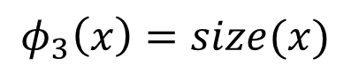
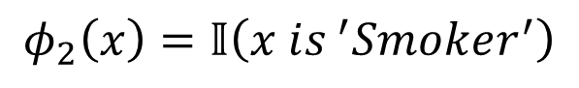
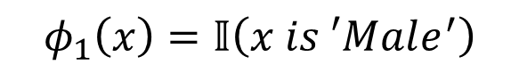
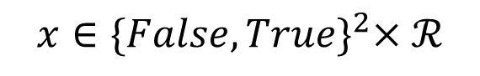
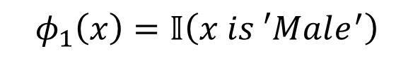
Linear Models and Feature Functions
Linear in the Parameters
Feature Functions
Domain:
$$x∈{\{False, True\}}^{2}×ℛ$$
For Example:
$$y_{i}=θ_{1}^{∗}+θ_{2}^{∗}𝕀\left(x_{i} is ′Male^{′}\right)+θ_{3}^{∗}𝕀\left(x_{i} is^{ ′}Smoker^{′}\right)+θ_{4}^{∗}size(x_{i})$$
Designing the feature functions is a big part of machine learning and data science.
Feature Functions
capture domain knowledge
substantial contribute to expressivity (and complexity)
Model:
Features:
Indicator functions
are a common method to transform qualitative data into quantitative data.
$$φ_{1}\left(x\right)=𝕀\left(x is ′Male^{′}\right)$$
$$φ_{2}\left(x\right)=𝕀\left(x is^{ ′}Smoker^{′}\right)$$
$$φ_{1}\left(x\right)=𝕀\left(x is ′Male^{′}\right)$$
$$φ_{3}\left(x\right)=size(x)$$

Slide 11
Linear Models and Feature Functions
Linear in the Parameters
Feature Functions
Question: Can a linear model do a good job of fitting y and x (to the right)?
Yes
No
C. Not sure

Slide 12
Linear Models and Feature Functions
Linear in the Parameters
Feature Functions
Yes:
Features:
← This is a linear model!
Linear in the parameters

Slide 13
Linear Models and Feature Functions
Linear in the Parameters
Feature Functions
For Example:
Features:
← This is a linear model!
Linear in the parameters

Slide 14
Linear Models and Feature Functions
Linear in the Parameters
Feature Functions
Designing feature functions is a big part of machine learning and data science.
Feature Functions
capture domain knowledge
substantial contribute to expressivity (and complexity)

Slide 15
Linear Models and Feature Functions
Linear in the Parameters
Feature Functions
What if x is a record with numbers, text, booleans, etc…
X
Y
uid | age | state | hasBought | review
0 | 32 | NY | True | ”Meh.”
42 | 50 | WA | True | ”Worked out of the box …”
57 | 16 | CA | NULL | “Hella tots lit yo ...”
rating
2.0
4.5
4.1
Answer:
Feature engineering

Slide 16
Feature Engineering
How do we define 𝜙?
Keeping it ℝeal

Slide 17
Feature Engineering
The process of transforming the inputs to a model to improve prediction accuracy.
A key focus in many applications of data science.
Feature Engineering enables you to:
capture domain knowledge (e.g., periodicity or relationships between features).
encode non-numeric features to be used as inputs to models.
express non-linear relationships using linear models.

Slide 18
Predict rating from review information
uid | age | state | hasBought | review
0 | 32 | NY | True | ”Meh.”
42 | 50 | WA | True | ”Worked out of the box …”
57 | 16 | CA | NULL | “Hella tots lit yo ...”
rating
2.0
4.5
4.1
int
int
string
boolean
string
float
Notes:
Note: Took away the Schema description since pre-reqs Data8, CS88, and CS61A do not use the term.

Slide 19
As a Linear Model?
uid | age | state | hasBought | review
0 | 32 | NY | True | ”Meh.”
42 | 50 | WA | True | ”Worked out of the box …”
57 | 16 | CA | NULL | “Hella tots lit yo ...”
rating
2.0
4.5
4.1
X=
Y=
int
int
string
boolean
string
float
Can I use X and Y directly in a linear model
No! Why?
Text, Categorical data, Missing values…
X
Domain

Slide 20
Basic Transformations
Uninformative features: (e.g., UID)
Is this informative (probably not?)
Transformation: remove uninformative features (why?)
Quantitative Features (e.g., Age)
Transformation: May apply non-linear transformations (e.g., log)
Transformation: Normalize/standardize (more on this later …)
Example: (x – mean)/stdev
Categorical Features (e.g., U.S. State)
How do we convert State into meaningful numbers?
Alabama =1 , …, Utah = 50 ?
Implies order/magnitude means something … we don’t want that ...
Transformation: One-hot-Encode
Notes:
9/27/2018: (Josh): Removed note about how dropping features could increase model variance since we have not discussed bias / variance tradeoff yet this semester.

Slide 21
One Hot Encoding (dummy encoding)
Transform categorical feature into many binary features:
state
NY
WA
CA
AK | … | CA | … | NY | … | WA | … | WY
0 | … | 0 | … | 1 | … | 0 | … | 0
0 | … | 0 | … | 0 | … | 1 | … | 0
0 | … | 1 | … | 0 | … | 0 | … | 0
Origin of the term: multiple “wires” for possible values one is hot …
Corresponding feature functions
Cat
Dog
See notebook for example code.
Fish

Slide 22
Encoding Missing Values
Missing values in Quantitative Data
Try to impute (estimate) missing values… (tricky)
Substitute the sample mean
Try more sophisticated algorithms to predict the missing value …
Add a boolean field called “missing_age”. (why?)
Sometimes the very fact that something is missing is useful.
Missing values in Categorical Data
Add an addition category called “missing_state”
Missing a Boolean? Some Boolean values can be converted into
True => +1, False => -1, Missing => 0

Slide 23
Encoding categorical data
Categorical Data ➔ One-hot encoding:
Text Data
Bag-of-words & N-gram models
“Learning about machine learning is fun.”
aardvark
machine
aardwolf
learning
zyzzyva
fun
Vector
0
0
…
1
…
2
…
1
…
0

Slide 24
Bag-of-words Encoding
Generalization of one-hot-encoding for a string of text:
Encode text as a long vector of word counts (Issues?)
Long = millions of columns →typically high dimensional and very sparse
Word order information is lost… (is this an issue?)
New unseen words at prediction (test) time → drop them …
A bag is another term for a multiset: an unordered collection which may contain multiple instances of each element.
Stop words: words that do not contain significant information
Examples: the, in, at, or, on, a, an, and …
Typically removed
“Learning about machine learning is fun.”
aardvark
machine
aardwolf
learning
zyzzyva
fun
Vector
0
0
…
1
…
2
…
1
…
0

Slide 25
I made this art piece in graduate school
Do you see the stop word?
There used to be a dustbin and broom
… but the janitors got confused …

Slide 26
N-Gram Encoding
Sometimes word order matters:
How do we capture word order in a “vector” model?
N-Gram: “Bag-of- sequences-of-words”
The book was not well written but I did enjoy it.
The book was well written but I did not enjoy it.

Slide 27
2-Gram Encoding
Removed stop words
The book was well written but I did not enjoy it.
book well
well written
written not
not enjoy
well written
not enjoy
written not
aardvark airlines
book well
apple pen
zyzzyva sf
Vector
0
0
…
1
…
1
…
1
…
1
…
0

Slide 28
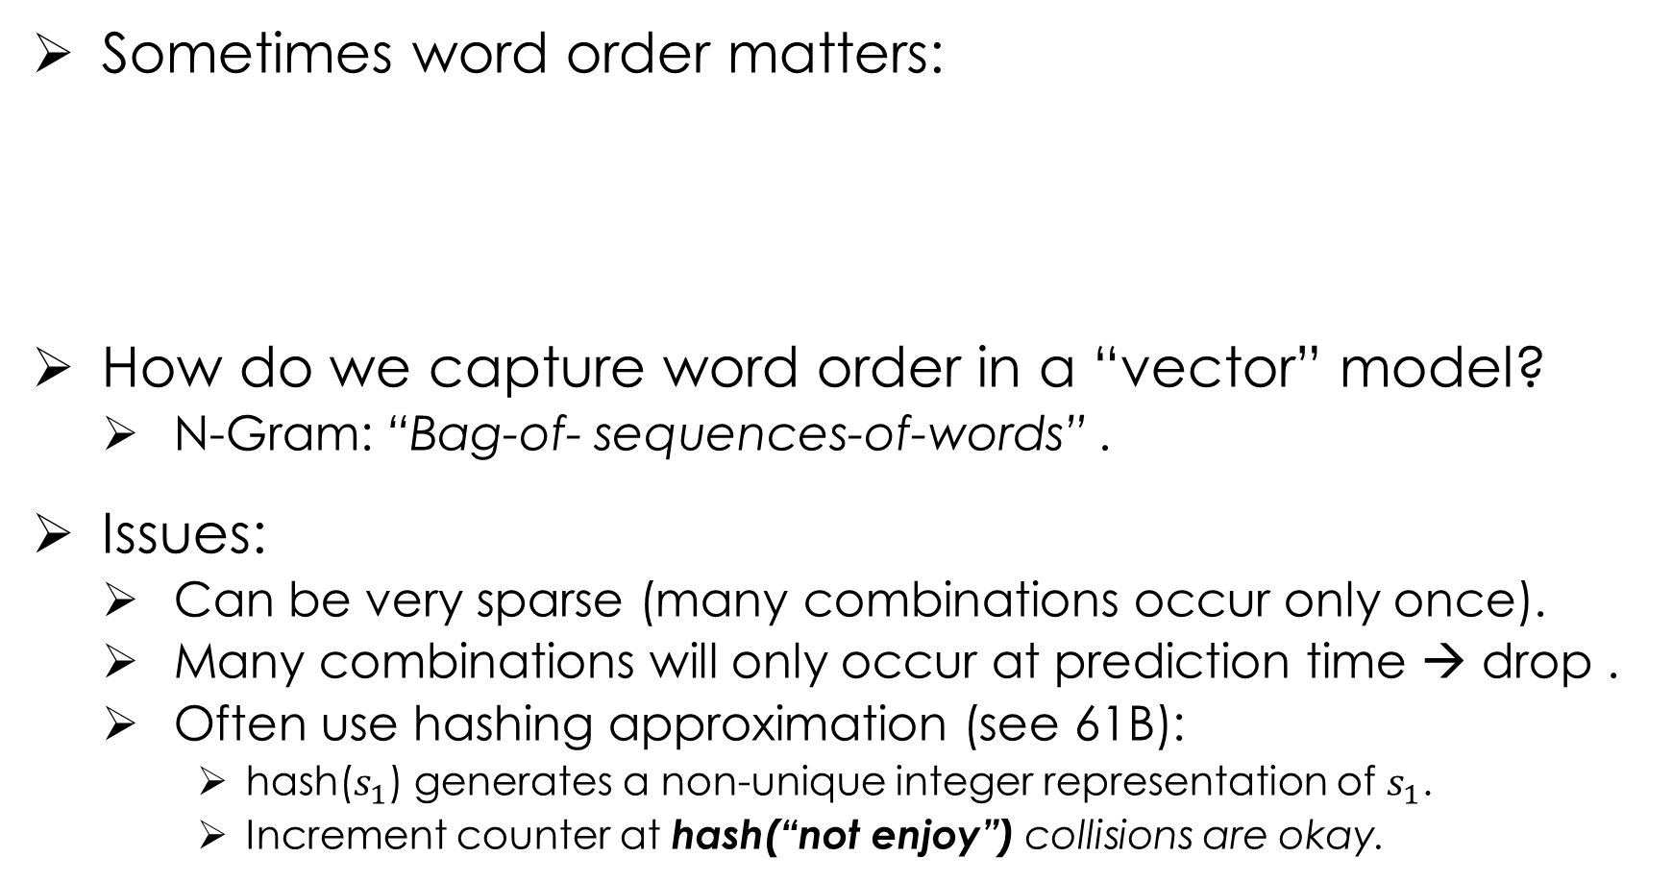
N-Gram Encoding
Sometimes word order matters:
How do we capture word order in a “vector” model?
N-Gram: “Bag-of- sequences-of-words” .
Issues:
Can be very sparse (many combinations occur only once).
Many combinations will only occur at prediction time → drop .
Often use hashing approximation (see 61B):
hash($s_{1}$) generates a non-unique integer representation of $s_{1}$.
Increment counter at hash(“not enjoy”) collisions are okay.
The book was not well written but I did enjoy it.
The book was well written but I did not enjoy it.

Slide 29
Feature Transformations to Capture Domain Knowledge
Feature functions capture domain knowledge by introducing additional information from other sources and/or combining features
Encoding non-linear patterns
Could do a database lookup
$$φ_{i}\left(x\right)=isDST\left(x_{date}, x_{location}\right)$$
Diurnal patterns.

Slide 30
Loss Minimization for Linear Models

Slide 31
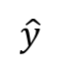
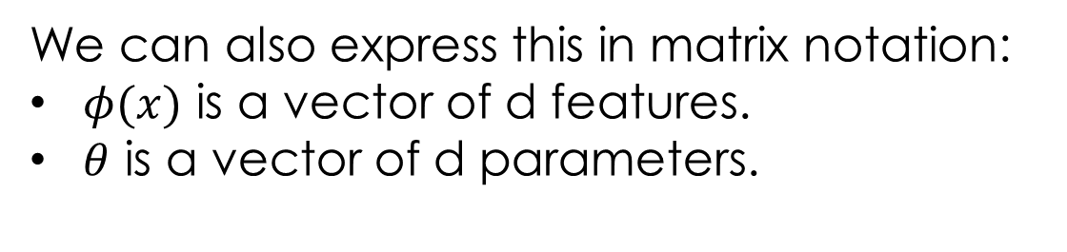
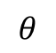
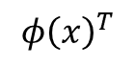

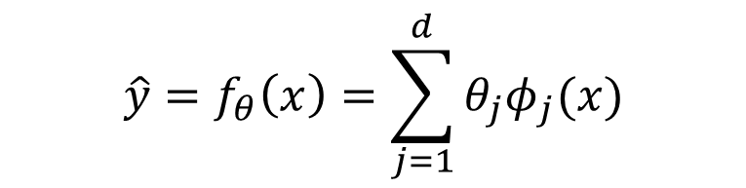
Linear Models in Matrix Notation
$$\hat{y}=f_{θ}\left(x\right)=\sum_{j=1}^{d}{θ_{j}φ_{j}(x)}$$
Earlier we discussed how our model takes an observation and produces a prediction.
We can also express this in matrix notation:
$φ(x)$ is a vector of d features.
$θ$ is a vector of d parameters.
$$\hat{y}=f_{θ}\left(x\right)=φ{\left(x\right)}^{T}θ$$
$$\hat{y}$$
$$φ{\left(x\right)}^{T}$$
$$θ$$
1
1
d
1
d
1

Slide 32
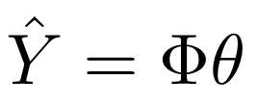
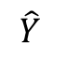
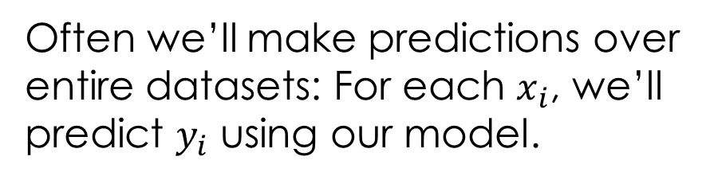
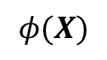

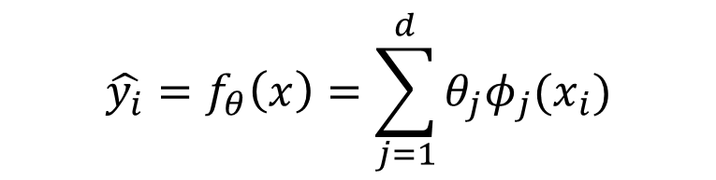
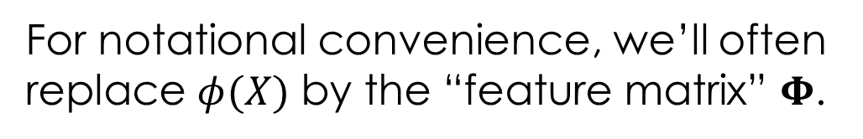
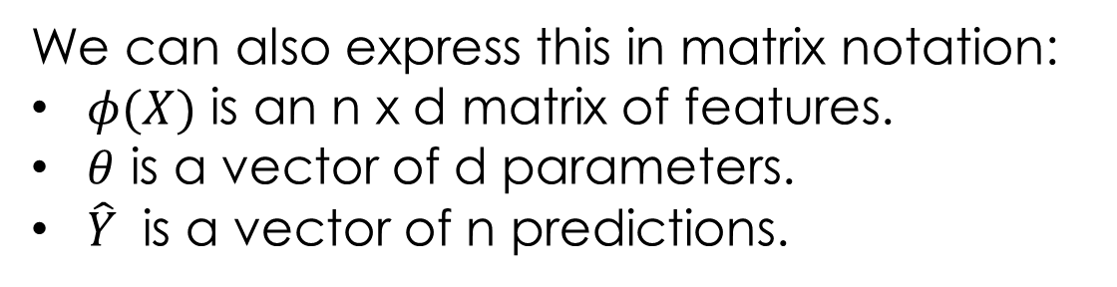
Linear Models in Matrix Notation
$$\hat{y_{i}}=f_{θ}\left(x\right)=\sum_{j=1}^{d}{θ_{j}φ_{j}(x_{i})}$$
Often we’ll make predictions over entire datasets: For each $x_{i}$, we’ll predict $y_{i}$ using our model.
We can also express this in matrix notation:
$φ(X)$ is an n x d matrix of features.
$θ$ is a vector of d parameters.
$\hat{Y}$ is a vector of n predictions.
$$\hat{Y}=f_{θ}\left(x\right)=φ(X)θ$$
$$\hat{Y}$$
$$φ(X)$$
$$θ$$
Our prediction for record #i is a linear combination of all d features of record #i.
n
n
d
1
For notational convenience, we’ll often replace $φ(X)$ by the “feature matrix” $Φ$.
1
d

Slide 33
The Feature Matrix
Domain
DataFrame (n x c)
uid | age | state | hasBought | review
0 | 32 | NY | True | ”Meh.”
42 | 50 | WA | True | ”Worked out of the box …”
57 | 16 | CA | NULL | “Hella tots lit...”
AK | … | NY | … | WY | age | hasBought | hasBought missing
0 | … | 1 | … | 0 | 32 | 1 | 0
0 | … | 0 | … | 0 | 50 | 1 | 0
0 | … | 0 | … | 0 | 16 | 0 | 1
Entirely Quantitative Values

Slide 34
The Feature Matrix
AK | … | NY | … | WY | age | hasBought | hasBought missing
0 | … | 1 | … | 0 | 32 | 1 | 0
0 | … | 0 | … | 0 | 50 | 1 | 0
0 | … | 0 | … | 0 | 16 | 0 | 1
Domain
Entirely Quantitative Values
n
Rows of the 𝚽 matrix correspond to records.
=
=
DataFrame
Columns of the 𝚽 matrix correspond to features.
Notation Guide
d
: row i of matrix A.
: column j of matrix A.
uid | age | state | hasBought | review
0 | 32 | NY | True | ”Meh.”
42 | 50 | WA | True | ”Worked out of the box …”
57 | 16 | CA | NULL | “Hella tots lit...”

Slide 35
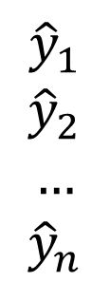
Making Predictions
AK | … | NY | … | WY | age | hasBought | hasBought missing
0 | … | 1 | … | 0 | 32 | 1 | 0
0 | … | 0 | … | 0 | 50 | 1 | 0
0 | … | 0 | … | 0 | 16 | 0 | 1
Entirely Quantitative Values
n
Domain
Rows of the 𝚽 matrix correspond to records.
=
=
DataFrame
Columns of the 𝚽 matrix correspond to features.
d
Prediction
$${\hat{y}}_{1}$$
$${\hat{y}}_{2}$$
$$…$$
$${\hat{y}}_{n}$$
n
=
=
d
uid | age | state | hasBought | review
0 | 32 | NY | True | ”Meh.”
42 | 50 | WA | True | ”Worked out of the box …”
57 | 16 | CA | NULL | “Hella tots lit...”

Slide 36
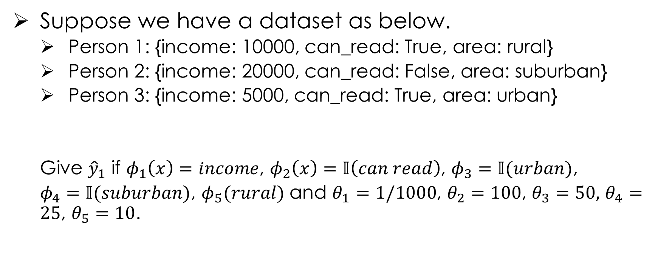
Attendance Quiz: yellkey.com/???
Suppose we have a dataset as below.
Person 1: {income: 10000, can_read: True, area: rural}
Person 2: {income: 20000, can_read: False, area: suburban}
Person 3: {income: 5000, can_read: True, area: urban}
Give ${\hat{y}}_{1}$ if $φ_{1}\left(x\right)=income$, $φ_{2}\left(x\right)=𝕀\left(can read\right)$, $φ_{3}=𝕀(urban)$,
$φ_{4}=𝕀(suburban)$, $φ_{5}(rural)$ and $θ_{1}=1/1000$, $θ_{2}=100$, $θ_{3}=50,$ $θ_{4}=25$, $θ_{5}=10$.

Slide 37
Summary of Notation
Domain
Feature Engineering
Linear
Regression

Slide 38
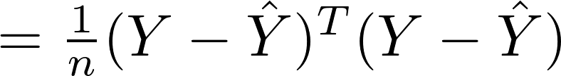

The Loss Function in Matrix Notation
$$\hat{Y}$$

Slide 39
The Loss Function in Matrix Notation
1
1
1
1
1
1
1
1
1
1
1
n
n
n
d
d
d
n
d
n
1
n
d
1
d
1
To minimize, we need to compute the gradient and set it equal to zero.

Slide 40
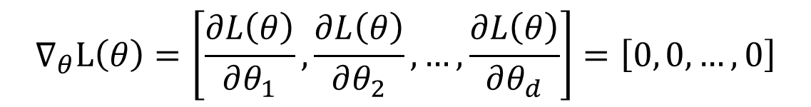
Minimizing the Loss
$$∇_{θ}L\left(θ\right)=\left[\frac{∂L\left(θ\right)}{∂θ_{1}},\frac{∂L\left(θ\right)}{∂θ_{2}}, …,\frac{∂L\left(θ\right)}{∂θ_{d}}\right]=\left[0, 0, …, 0\right]$$
Could expand out $L\left(θ\right)$ and do calculus + algebra, but this would be incredibly tedious! (might be worth doing to test your understanding).
$$L\left(θ\right)=\frac{1}{n}\left(\left(y_{1}^{2}+y_{2}^{2}+…y_{n}^{2}\right)−2\left(\left(y_{1}φ_{11}+y_{2}φ_{21}+…y_{n}φ_{n1}\right)θ_{1}+…\right)+…\right)$$
Instead, let’s do everything natively in matrix notation.

Slide 41
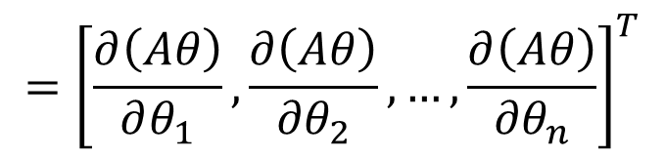
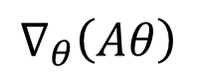
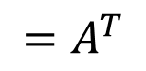
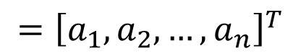
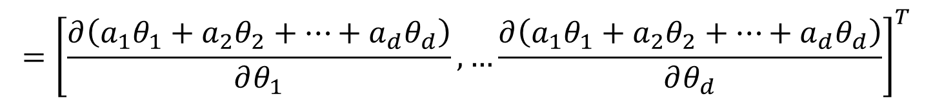
Some Useful Matrix Calculus Rules
Let’s discuss a couple of rules, that are useful to us.
First: $∇_{θ}\left(Aθ\right)=A^{T}$, where $A$ and $θ$ are 1 x d and d x 1, respectively.
Transpose because we want gradient to be a column vector!
$$={\left[\frac{∂\left(Aθ\right)}{∂θ_{1}},\frac{∂\left(Aθ\right)}{{∂θ}_{2}}, …,\frac{∂\left(Aθ\right)}{{∂θ}_{n}}\right]}^{T}$$
$$∇_{θ}\left(Aθ\right)$$
$$={\left[\frac{∂\left(a_{1}θ_{1}+a_{2}θ_{2}+…+a_{d}θ_{d}\right)}{∂θ_{1}},…\frac{∂\left(a_{1}θ_{1}+a_{2}θ_{2}+…+a_{d}θ_{d}\right)}{∂θ_{d}}\right]}^{T}$$
$$={\left[a_{1},a_{2}, …,a_{n}\right]}^{T}$$
$$=A^{T}$$

Slide 42
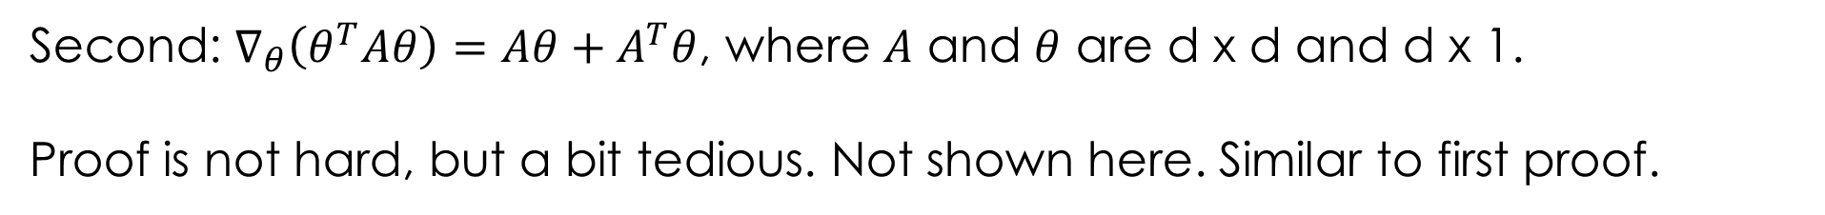
Some Useful Matrix Calculus Rules
Second: $∇_{θ}\left(θ^{T}Aθ\right)=Aθ+A^{T}θ$, where $A$ and $θ$ are d x d and d x 1.
Proof is not hard, but a bit tedious. Not shown here. Similar to first proof.
Useful Matrix Derivative Rules:
(1)

Slide 43
Optimizing the Loss Algebraically
Deriving the Normal Equation
Rule 1
Rule 2
Useful Matrix Derivative Rules:
Taking the Gradient of the loss
(1)
(2)
Setting the gradient equal to 0 and solving for θ:
“Normal Equation”

Slide 44
Optimizing the Loss Geometrically
There is an alternate derivation for the normal equation.
This one provides much more intuition, but requires a deeper understanding of linear algebra.
Understanding this is required for the course. Will vary widely in how much effort it takes to fully grok.

Slide 45
Optimizing the Loss Geometrically
Our observations Y form a single vector in an n-dimensional space.
Maybe it’s the observed weight of all n people in Berkeley: [120, 190, 210, 9.3, …]
n dimensional space
Y

Slide 46
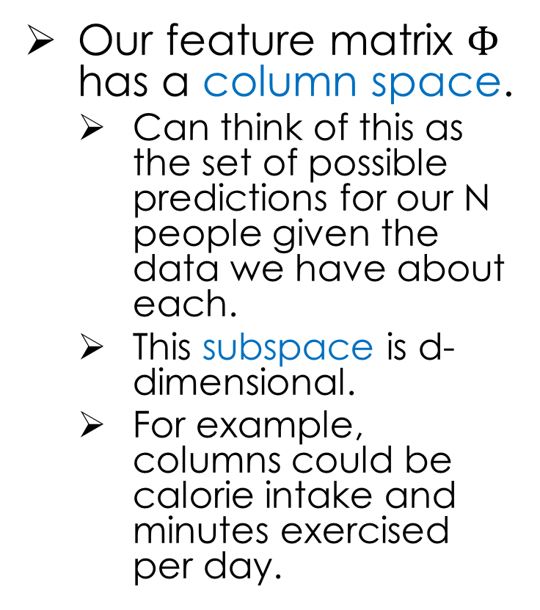
Optimizing the Loss Geometrically
Our feature matrix $Φ$ has a column space.
Can think of this as the set of possible predictions for our N people given the data we have about each.
This subspace is d-dimensional.
For example, columns could be calorie intake and minutes exercised per day.
n dimensional space
Y
d dimensional subspace

Slide 47
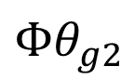
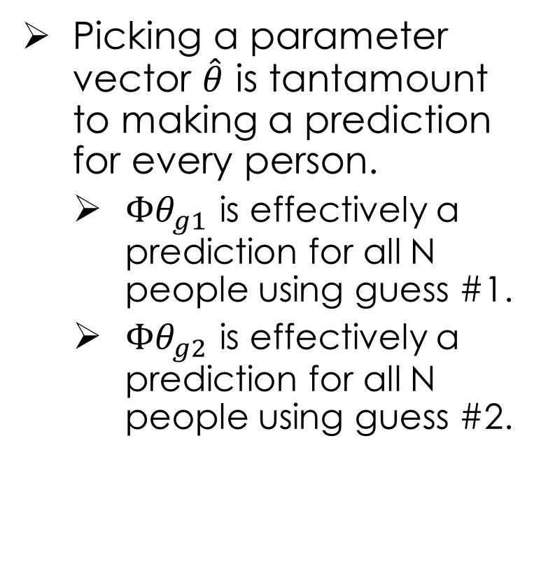
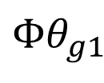
Optimizing the Loss Geometrically
Picking a parameter vector $\hat{θ}$ is tantamount to making a prediction for every person.
$Φθ_{g1}$ is effectively a prediction for all N people using guess #1.
$Φθ_{g2}$ is effectively a prediction for all N people using guess #2.
n dimensional space
Y
d dimensional subspace
$$Φθ_{g1}$$
$$Φθ_{g2}$$

Slide 48
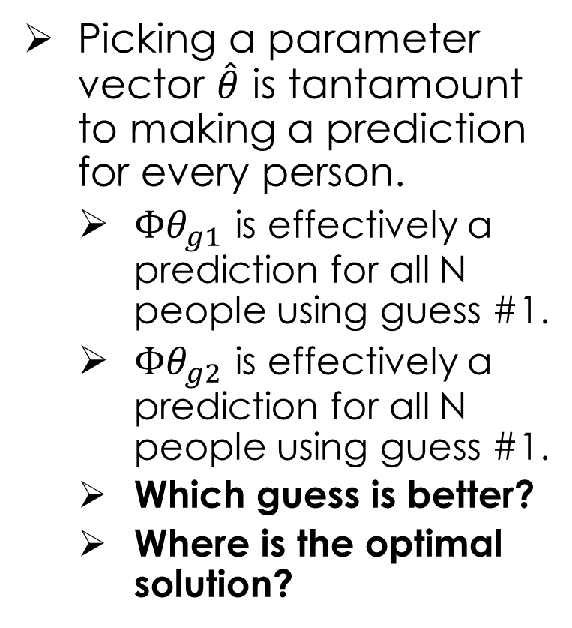
Optimizing the Loss Geometrically
Picking a parameter vector $\hat{θ}$ is tantamount to making a prediction for every person.
$Φθ_{g1}$ is effectively a prediction for all N people using guess #1.
$Φθ_{g2}$ is effectively a prediction for all N people using guess #1.
Which guess is better?
Where is the optimal solution?
n dimensional space
Y
d dimensional subspace
$$Φθ_{g1}$$
$$Φθ_{g2}$$

Slide 49
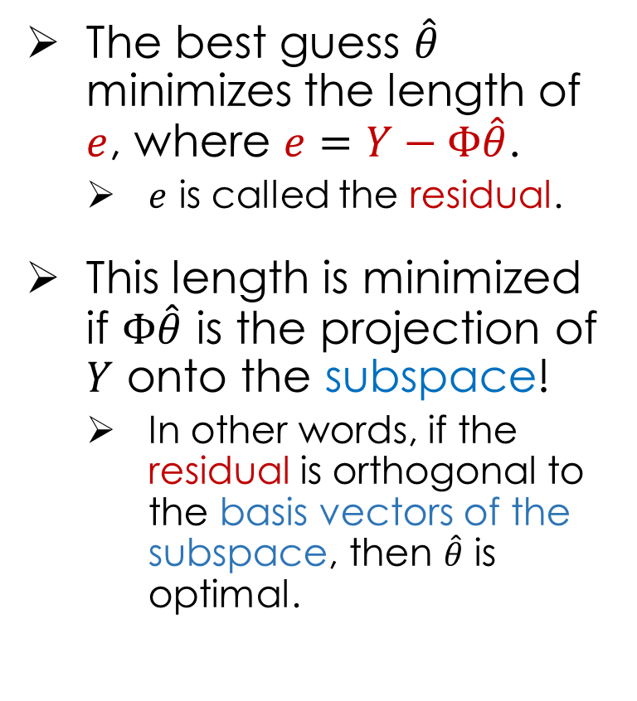
Optimizing the Loss Geometrically
The best guess $\hat{θ}$ minimizes the length of $e$, where $e=Y−Φ\hat{θ}$.
$e$ is called the residual.
This length is minimized if $Φ\hat{θ}$ is the projection of $Y$ onto the subspace!
In other words, if the residual is orthogonal to the basis vectors of the subspace, then $\hat{θ}$ is optimal.
n dimensional space
Y
d dimensional subspace
$$Φθ_{g1}$$
More on this in discussion!

Slide 50
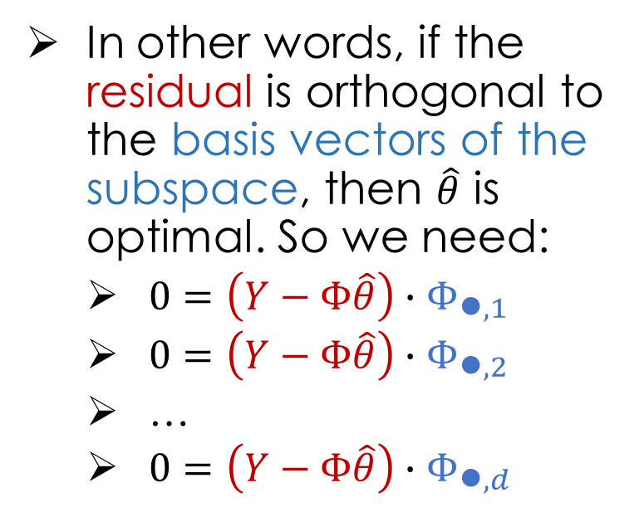

Optimizing the Loss Geometrically
In other words, if the residual is orthogonal to the basis vectors of the subspace, then $\hat{θ}$ is optimal. So we need:
$0=\left(Y−Φ\hat{θ}\right)∙Φ_{\text{●},1}$
$0=\left(Y−Φ\hat{θ}\right)∙Φ_{\text{●},2}$
…
$0=\left(Y−Φ\hat{θ}\right)∙Φ_{\text{●},d}$
n dimensional space
Y
d dimensional subspace
$$Φθ_{g1}$$
Or more simply:
$$0=Φ^{T}\left(Y−Φ\hat{θ}\right)$$

Slide 51
Geometric Derivation: Not Bonus Material
We decided that this is too exciting to not know.
n dimensional space
Y
Columns space of 𝚽
n
n
=
d dimensional subspace
d
1
Derivation
Definition of orthogonality
“Normal Equation”
d x n
n x 1 residual

Slide 52
The Normal Equation
Optimizing Linear models is therefore very easy:
Given $Φ$ and $Y$, compute ${\left(Φ^{T}Φ\right)}^{−1}Φ^{T}Y$ and you’re done.
Note: For ${\left(Φ^{T}Φ\right)}^{−1}$to exist $Φ$ needs to be full column rank.
No collinear columns.
Why? Prove yourself, or see https://www.youtube.com/watch?v=ESSMQH6Y5OA.
Don’t have full rank? Add regularization (coming soon).
Let’s try it out!
Notes:
https://www.khanacademy.org/math/linear-algebra/matrix-transformations/matrix-transpose/v/lin-alg-showing-that-a-transpose-x-a-is-invertible

Slide 53
Numerical Optimization of Linear Models

Slide 54
The Normal Equation
Optimizing Linear models is therefore very easy:
Given $Φ$ and $Y$, compute ${\left(Φ^{T}Φ\right)}^{−1}Φ^{T}Y$ and you’re done.
In practice, rather than using algebraic expressions, we’ll use
use numerical methods (e.g., scikit-learn) to estimate θ.
Let’s do what we just did, but now using scikit-learn.
Notes:
https://www.khanacademy.org/math/linear-algebra/matrix-transformations/matrix-transpose/v/lin-alg-showing-that-a-transpose-x-a-is-invertible

Slide 55
Least Squares Regression in Practice
Use optimized software packages
Address numerical issues with matrix inversion
Incorporate some form of regularization
Address issues of collinearity
Produce more robust models
We will be using scikit-learn:
http://scikit-learn.org/stable/modules/linear_model.html
See Homework 6 for details!

Slide 56
Scikit Learn Models
Scikit Learn has a wide range of models
Many of the models follow a common pattern:
from sklearn import linear_model
f = linear_model.LinearRegression(fit_intercept=True)
f.fit(train_data[['X']], train_data['Y'])
Yhat = f.predict(test_data[['X']])
Ordinary Least Squares Regression

Slide 57
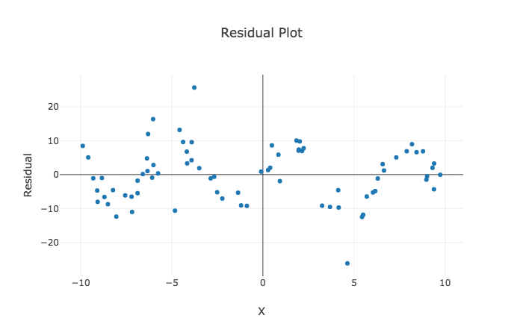
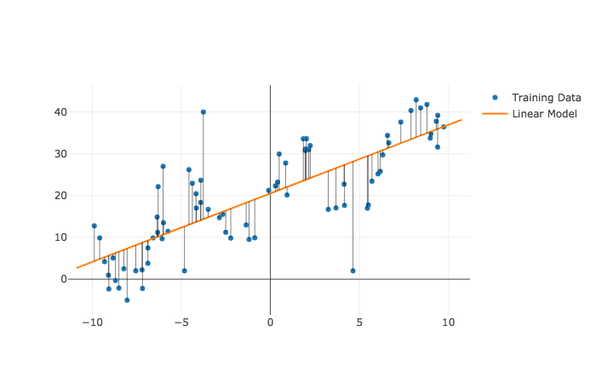
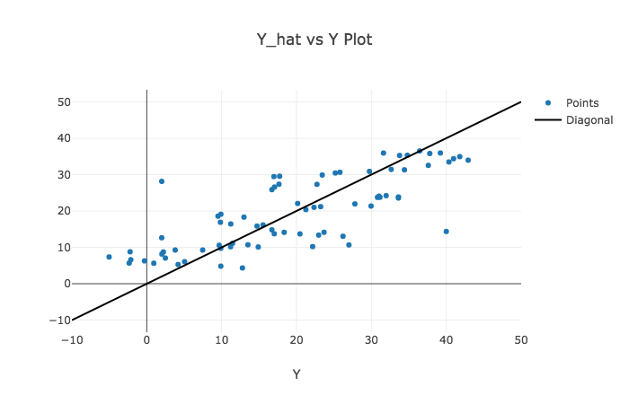
Diagnosing Fit → The Residuals
Dependence on each feature
Residuals
Predicted Y vs True Y
Look at Spread

Slide 58
Conclusion and Notation

Slide 59

Recap: Feature Engineering
Notation: Computer scientist / ML researchers tend to you d (dimensions) and statisticians will use p (parameters).
Linear models with feature functions:
Feature Functions:
p
Domain

Slide 60
One-hot encoding: Categorical Data
Bag-of-words & N-gram: Text Data
Custom Features: Domain Knowledge

Slide 61
The Feature Matrix
Domain
DataFrame
uid | age | state | hasBought | review
0 | 32 | NY | True | ”Meh.”
42 | 50 | WA | True | ”Worked out of the box …”
57 | 16 | CA | NULL | “Hella tots lit...”
AK | … | NY | … | WY | age | hasBought | hasBought missing
0 | … | 1 | … | 0 | 32 | 1 | 0
0 | … | 0 | … | 0 | 50 | 1 | 0
0 | … | 0 | … | 0 | 16 | 0 | 1
Entirely Quantitative Values
Another quick note on confusing notation.
In many textbooks and even in the class notes and discussion you will see:
and
In this case we are assuming X is the transformed data 𝚽. This can be easier to read but hides the feature transformation process.
Capital Letter: Matrix or Random Variable?
Both tend to be capitalized
Unfortunately, there is no common convention … you will have to use context.

